Slide 1
Book Recommender
Using data to recommend similar books from Amazon
Byungchan Kim
Springboard Capstone Project

Slide 2
Overview
Problem
Data Scoping
Data Wrangling
Exploratory Data Analysis
Content-based Recommender
Retrospective

Slide 3
Problem
Everyone’s taste in literature is different.
Wouldn’t it be great if we can get recommendations for the next book to read?
Notes:
It is very easy to go to a bookstore's ‘horror’ section and pick up the book next to the reader’s favorite horror book. But the only connection between the first book and the second is that they are both classified as ‘horror’ and there is only a slim chance a reader will like all horror books . The probability that a reader will like the second horror book becomes pretty low.
So what are the predictors to keep track of? What sort of information is critical when an individual makes a purchase decision? Our goal is to gather these data and come up with a personalized list of items that a certain individual may have interests in.

Slide 4
Data Scoping
Data sourced from UCSD CompSci Department
http://deepyeti.ucsd.edu/jianmo/amazon/index.html
Source contains all review and product Amazon data
For this learning project, only considering below data
Review for Books
Products for Books
Notes:
Originally, all review dataset was at scope to build the recommender but the sheer size of the data made this impossible. So it was decided to pick a category and build a recommender for a specific category.

Slide 5
Initial Data Wrangling
Review dataset
Checked for duplicates and null
Columns dropped example: image, style, vote, unixReviewTime ..
Removed all book reviews with less than 50 reviews
Product dataset
Checked for duplicates and null
Columns dropped example: image, price, tech1, tech2 ...
Notes:
Further details in the report

Slide 6
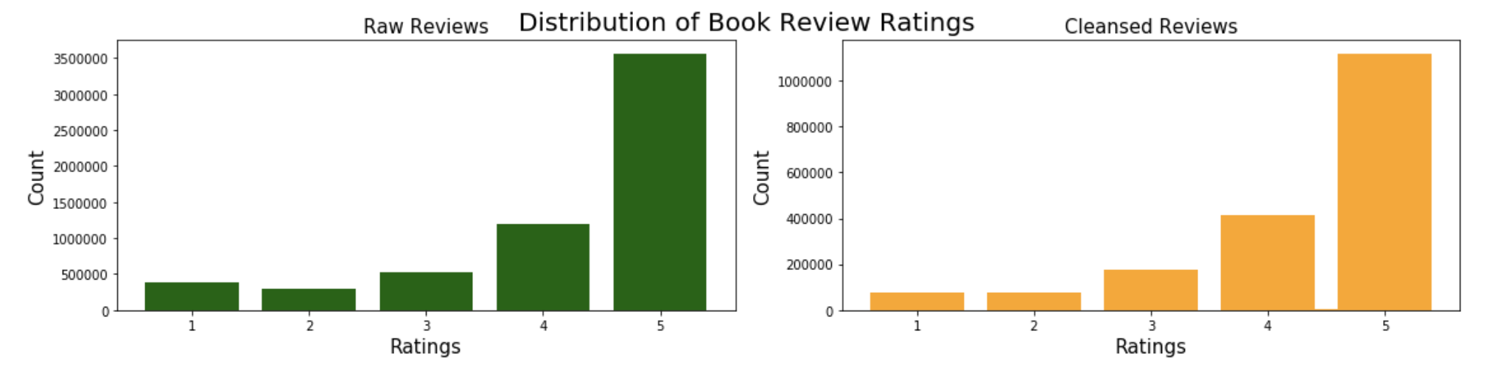
Exploratory Data Analysis
Understanding the Review Data
Notes:
The distribution of overall ratings is heavily skewed. Sheer number of 5-star reviews looks to be higher than the sum of all remaining four star ratings. Also, the before and after trimming seemed to carry over the overall distribution.

Slide 7
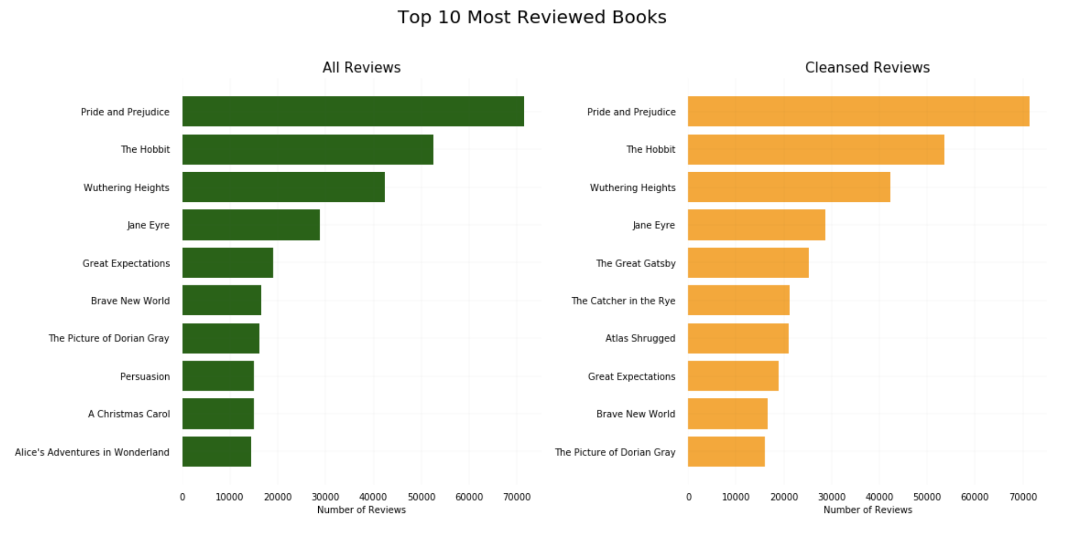
Exploratory Data Analysis
Notes:
Interestingly, even with all the data trimming, the top 10 books with most reviews have not changed a lot as well as the number of actual reviews.
This means our cleansed dataset is maintaining the data characteristics from the total dataset.

Slide 8
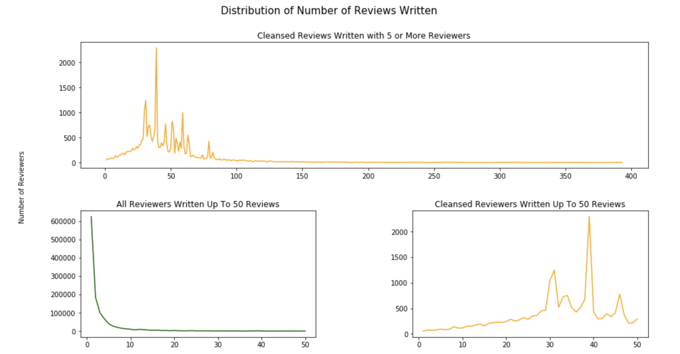
Exploratory Data Analysis
Notes:
Top most plot shows the distribution of the number of reviews written after low count data trimming. Although we set the low count to 30, we can see there are still reviewers with less than 50 reviews as noted in the plot below. This is due to our additional ASIN trimming after trimming the number of reviewers down. This decision was made as it is acceptable to have reviewers write less than 30 reviews but each product must have at least 50 reviews.
Second-row's left plot shows the distribution for all reviewers written up to 50 reviews. Important thing to note from this plot is how many reviews have been written by users who have never reviewed or only reviewed a few products as the steeply decreasing tail represents. The left-tail eventually trickles down to 1 (at max, 1 reviewer wrote 3680 reviews).

Slide 9
Content-based Recommender
Text Preprocessing
Further trim down dataset
Aggregate text data to a single column
Data does not contain punctuation
Data does not contain null words
Tokenize each words
Lemmatize words to their root word

Slide 10
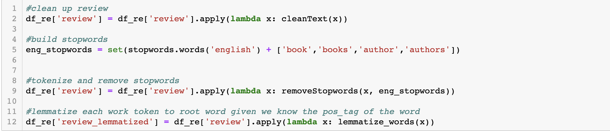
Content-based Recommender
Text Preprocessing

Slide 11
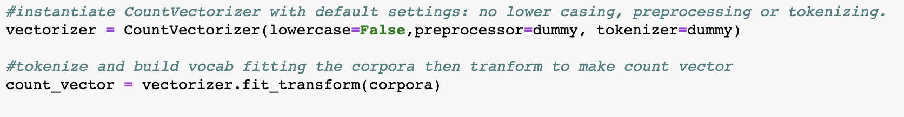
Content-based Recommender
Finding Vectorizer Parameter
Min_df : 5
Max_df : 0.5
Max_features : 50000
Notes:
After testing through multiple iterations of vectorizers, following hyperparameters were chosen.
Min_df : 5
We have at least 30 reviews per product, 5 was chosen to reduce any words counts that are one-off.
Max_df : 0.5
Since we are dealing with people’s opinions instead of the product descriptions, words that appear in more than half of the corpora are considered unneeded.
Max_features : 50000

Slide 12
Content-based Recommender
Further Issues Found
Tokens that start with _
Tokens with numeric variables
Tokens that starts with number then string
Tokens that are noisy data, ie. SPAM
Notes:
In the prior data cleaning, we have checked the duplicates for the entire rows but further processing revealed there were reviewers making the same reviews to different books passing the null check.
To account for this, the original dataset was imported again and cleaned.

Slide 13
Content-based Recommender
Tf-idf Transformer
using Tf-idf Transformer and Count Vectorizer as using custom tokenizer, word cleansing and lemmatizer
Notes:
In the prior data cleaning, we have checked the duplicates for the entire rows but further processing revealed there were reviewers making the same reviews to different books passing the null check.
To account for this, the original dataset was imported again and cleaned.

Slide 14
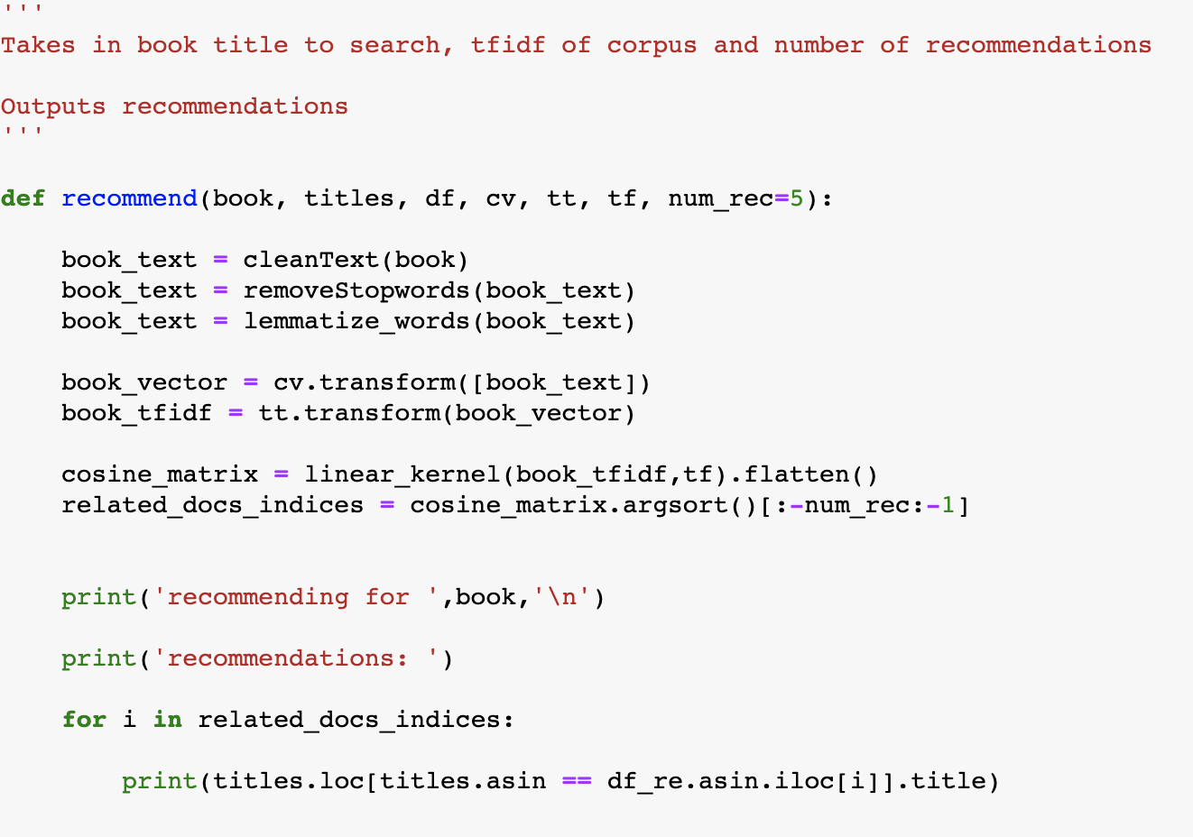
Content-based Recommender
Cosine Similarity
Notes:
Simple code was written to create the input search text as a vectorizer on the fly and make comparison. This method was chosen due to our data size. We could create the cosine similarity matrix for all possible documents however we lacked the firepower to do so. Therefore, we have kept all the components in memory and made recommendations on the fly.

Slide 15
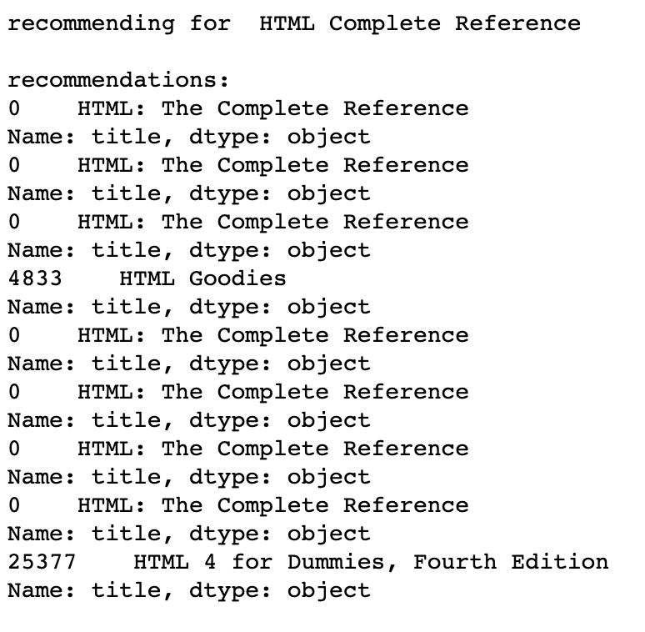
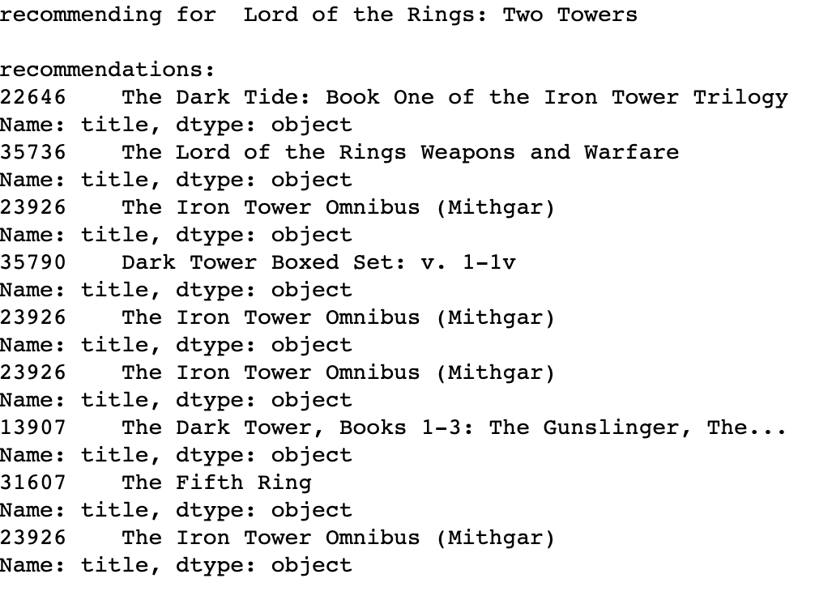
Content-based Recommender
Results
Notes:
Simple code was written to create the input search text as a vectorizer on the fly and make comparison. This method was chosen due to our data size. We could create the cosine similarity matrix for all possible documents however we lacked the firepower to do so. Therefore, we have kept all the components in memory and made recommendations on the fly.

Slide 16
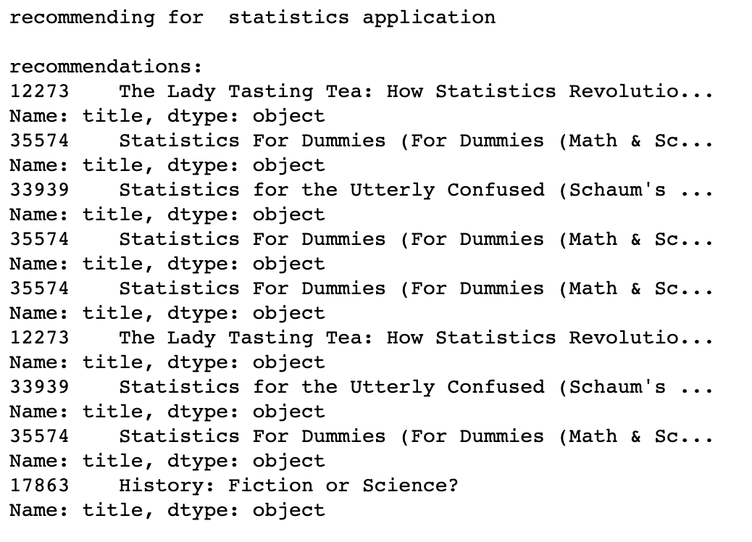
Content-based Recommender
Results
Notes:
Our review-based recommender is providing the same recommendation multiple times. This is due to multiple reviews being available for each book. We could further expand our recommender to skip the asin if they were selected to be recommended in the future. However, we are seeing the limitation of review content based recommender systems as the keywords are determined by the user reviews. Although our current recommender system is doing a good job in recommending similar (mostly the same for now) books, there were many manual data trimming involved to keep the corpora manageable. This means that the corpora itself was built by the decision of the developer to keep certain reviews or not introducing bias. This may not work best in production situations.

Slide 17
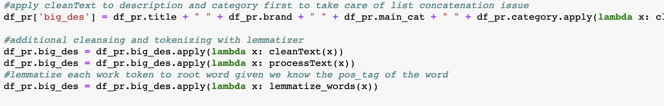
Content-based Recommender
Product dataset
Same data cleansing methods applied to product dataset
As opposed to Review, this dataset contains one entry per product with its descriptions.
Text Preprocessing

Slide 18
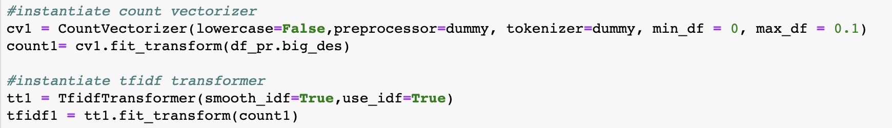
Content-based Recommender
Count Vectorizer / Tf-Idf Transformer
Notes:
Max_features is not set here because we want to capture all descriptive words.
Min_df : 0 to capture all
Max_df: 0.1 as we are focusing on identifying unique keywords

Slide 19
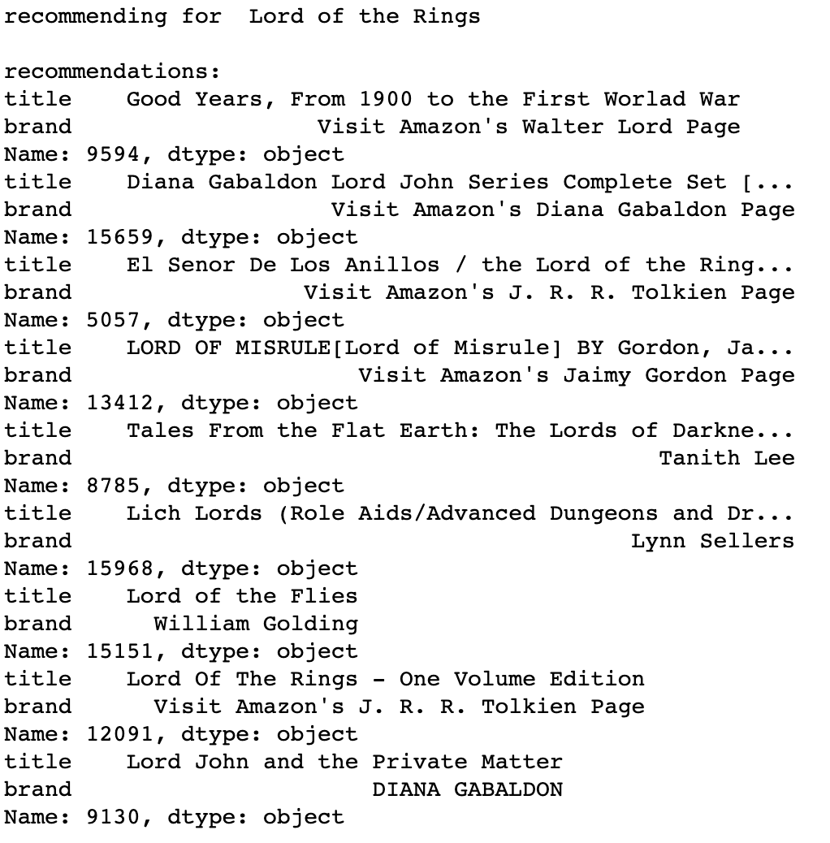
Content-based Recommender
Result
Notes:
Including product descriptions and other data has definitely expanded the range of recommendation. <br> This is a much better version of the recommender as this can also recommend books that are in the same category or same author or even with similar descriptions.

Slide 20
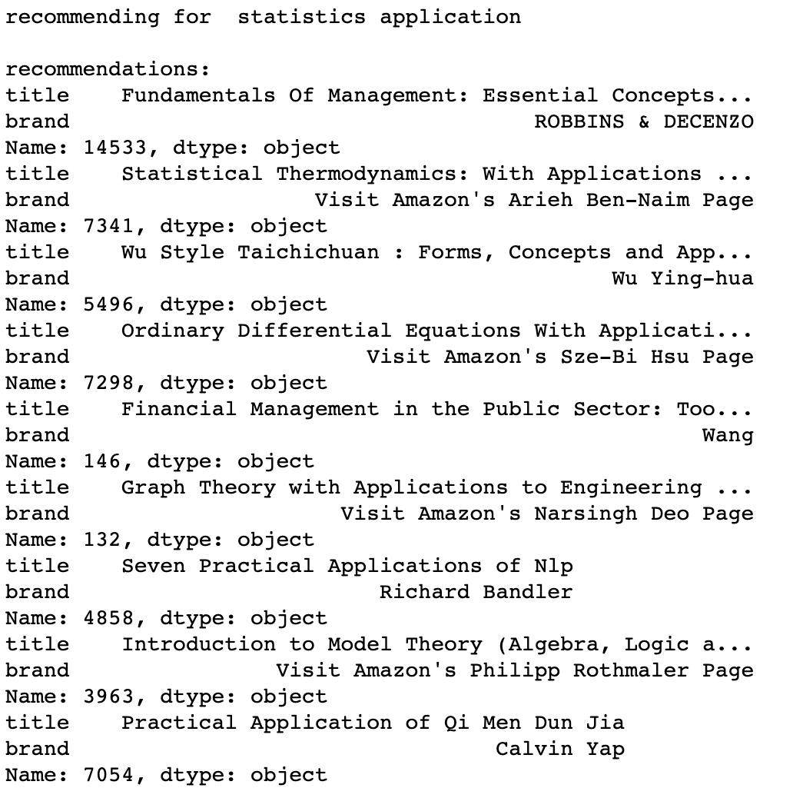
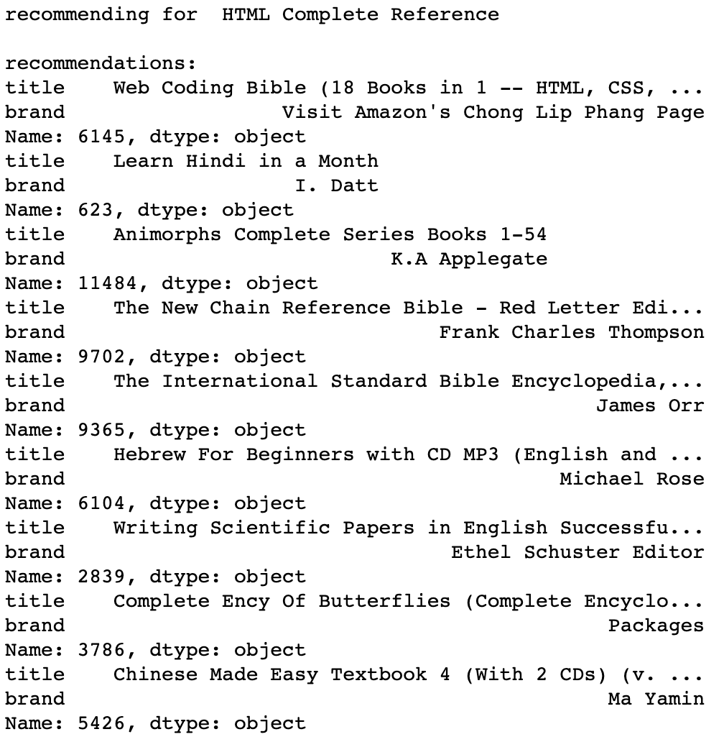
Content-based Recommender
Results

Slide 21
Retrospective
Review-based Recommender
What could be done to fix it?
Why doesn’t it make sense?
Collaborative Filtering
Going Forward
What else would we add to improve the model?
Notes:
Review Dataset
Although it was decided that review dataset was not fit to build the content based filtering recommender, it is not impossible to do so.
Our issue with this type of recommender was that the same products recommended multiple times.
We can add an extra step in the model to remove and select the next highest product with similarity if the product was already recommended.
One of the reasons this recommender is not suitable for production is that the vocabulary built for the model was mostly from user’s reviews. This means that they may not all be facts and many are opinions. For this to be used in business, we would require a team that monitors for valid reviews and track reviewers for their reviews essentially to monitor what kind of new words are added to the vocabulary and for each product. This sounds like more work for barely any gains if we can just use factual descriptive keywords for the search terms.
Collaboraitve Filtering
Collaborative filtering was also on the trajectory of this project. Although user purchase history was not available, each products had info for also_view and also_bought which could be used to build the item-user frequency matrix. However, during the course of the project, our data was heavily trimmed down and the item-user frequency matrix could not be built due to sparsity.
Going Forward
Our results show using the product metadata for search/recommender system works smoothly. We can further improve the quality of the search and recommendation by adding more and more accurate keywords to our products going into genres and even names. We can also incorporate ratings data to give weights to books that are popular. Once user related data also becomes available, we will be able to create different recommendation solution for different age/sex and locality groups.

